Slide 1
Data Types

Slide 2
How are they stored
Stored using binary (0 or 1)
Byte - Basic unit of memory
8 bits
All data types stored this way
int : 32 bit (4 bytes)
char : 8 bit (1 byte)

Slide 3
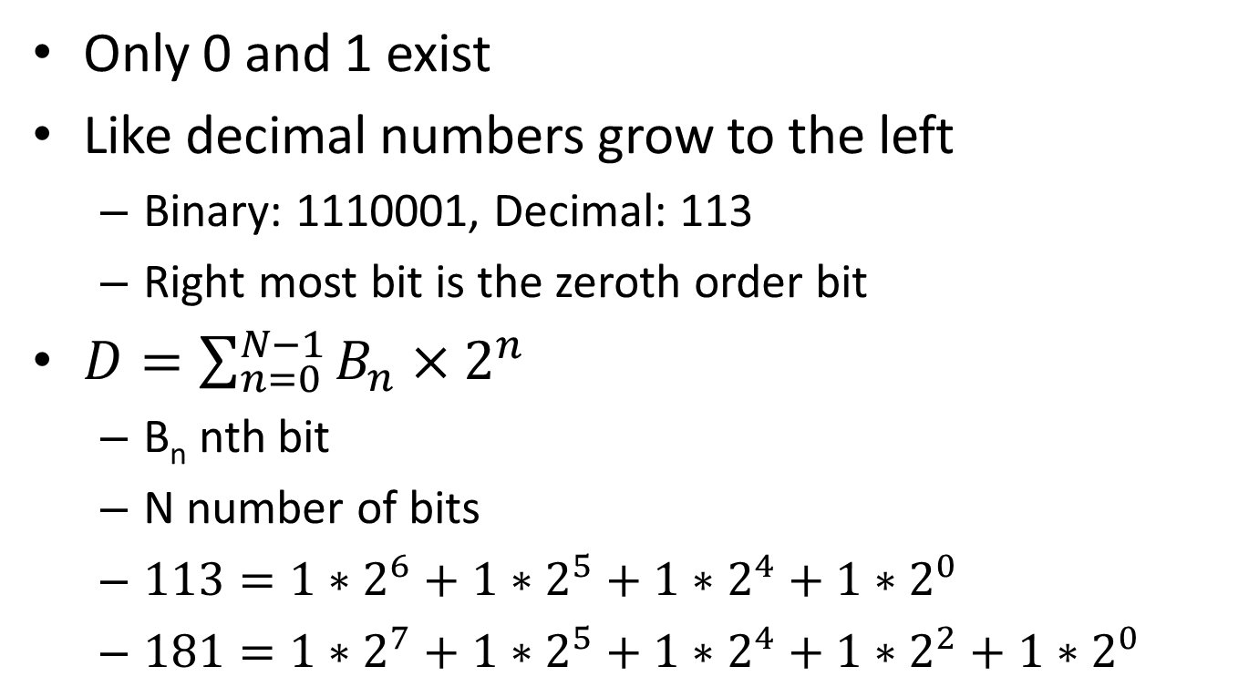
Quick Note: Binary
Only 0 and 1 exist
Like decimal numbers grow to the left
Binary: 1110001, Decimal: 113
Right most bit is the zeroth order bit
$D=\sum_{n=0}^{N−1}{B_{n}×2^{n}}$
B_{n} nth bit
N number of bits
$113=1∗2^{6}+1∗2^{5}+1∗2^{4}+1∗2^{0}$
$181=1∗2^{7}+1∗2^{5}+1∗2^{4}+1∗2^{2}+1∗2^{0}$

Slide 4
Integer Types
int
32 bit
Signed (allows negative and positive numbers)
Range: -2³² to 2³²-1 (-2,147,483,648 to 2,147,483,647)
2’s complement
31 bits
Flag Bit
If 0, then positive
If 1, then negative

Slide 5
2’s Complement
For decimal integers
a+(-a) = 0 ex: 19+(-19) = 0
Most modern CPUs are binary
Not only binary
Only positive binary
How do we add two positive numbers and get Zero?
Multiple candidate methods
We will only look at 2’s complement

Slide 6
2’s Complement (cont.)
Integer representation exists in word space
A word is 32 bits on most machines
64 bit is working its way out
Use this to our advantage
No number can be larger than 2³²-1
It will just wrap back around to 0
Present two methods
Purely binary
Simplified decimal

Slide 7
2’s Complement (cont.)
Assume 8 bit word space
Some number 10010011
10010011 10010011
XOR 11111111 + 01101101
01101100 00000000
+ 00000001
01101101
01101101 is the 2’s complement of 10010011

Slide 8
Quick Note: Hexidecimal
Values
0,1,2,3,4,5,6,7,8,9,A,B,C,D,E,F
Each hexidecimal number rep’s a 4 bit number
0 = 0000 4 = 0100 8 = 1000 C = 1100
1 = 0001 5 = 0101 9 = 1001 D = 1101
2 = 0010 6 = 0110 A = 1010 E = 1110
3 = 0011 7 = 0111 B = 1011 F = 1111
N bit number is rep’ed by N/4 hexit number
11111111₂=0xFF₁₆ 10110010₂ = B2₁₆

Slide 9
2’s Complement (cont.)
Algorithm for finding 2’s Complement
Have binary number that populates word space
XOR the number with 0xF…F (Binary rep of 2^{N}-1)
Add 0x1
This guarantees 0x0 when a number is added to its 2’s complement

Slide 10
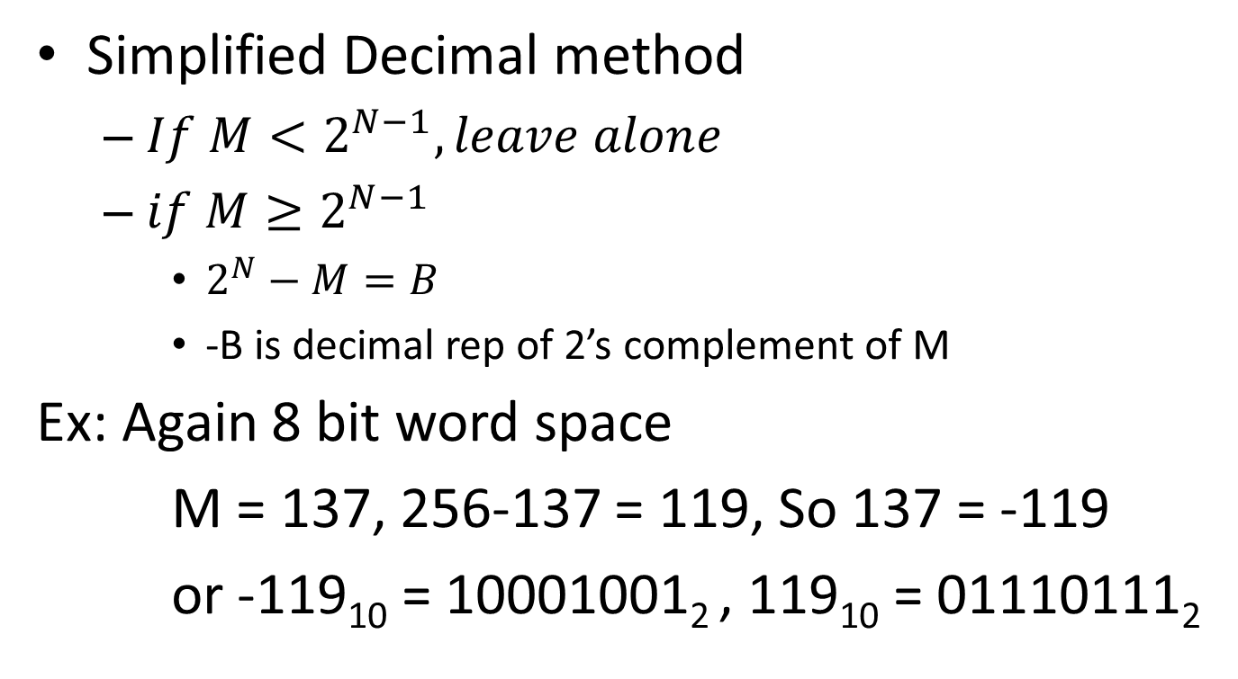
2’s Complement (cont.)
Simplified Decimal method
$If M<2^{N−1}, leave alone$
$if M≥2^{N−1}$
$2^{N}−M=B$
-B is decimal rep of 2’s complement of M
Ex: Again 8 bit word space
M = 137, 256-137 = 119, So 137 = -119
or -119₁₀ = 10001001₂ , 119₁₀ = 01110111₂

Slide 11
2’s Complement (cont.)
Range of 2’s complement
[-2^{N-1},2^{N-1}-1]
Ex: 3 bit word space
0 = 000 -4 = 100
1 = 001 -3 = 101
2 = 010 -2 = 110
3 = 011 -1 = 111

Slide 12
Integer Types (Cont.)
unsigned int
32 bit
Unsigned (only allows 0 and positive numbers)
Range: 0 to 2³²-1 (0 to 4,294,967,295)
32 bits
No Flag Bit

Slide 13
Integer Types (cont.)
short
16 bit
Signed by default (2’s complement)
Range: -2¹⁶ to 2¹⁶-1 (-32768 to 32767)
Declare unsigned short
Range: 0 to 2¹⁶-1 (0 to 65535)
Mainly used when dealing with sockets and ports

Slide 14
Integer Types (cont.)
long
64 bit
Signed by default
Range: -2⁶⁴ to 2⁶⁴-1 (approx -9*10¹⁸ to 9*10¹⁸)
Declare unsigned long
Range: 0 to 2⁶⁴-1 (0 to approx 1.8*10¹⁹)

Slide 15
Floating Point Types
float
32 bit
Defined by IEEE 754
Always signed
Range: approx -8.3*10³⁸ to 8.3*10³⁸
Number representation
Similar to scientific notation
Mantissa(significand), base, exponent

Slide 16
Floating Point Types (cont.)
double
64 bit
Defined by IEEE 754
Always signed
Range: approx -9*10³⁰⁸ to 9*10³⁰⁸
Number representation
Similar to scientific notation
Mantissa(significand), base, exponent

Slide 17
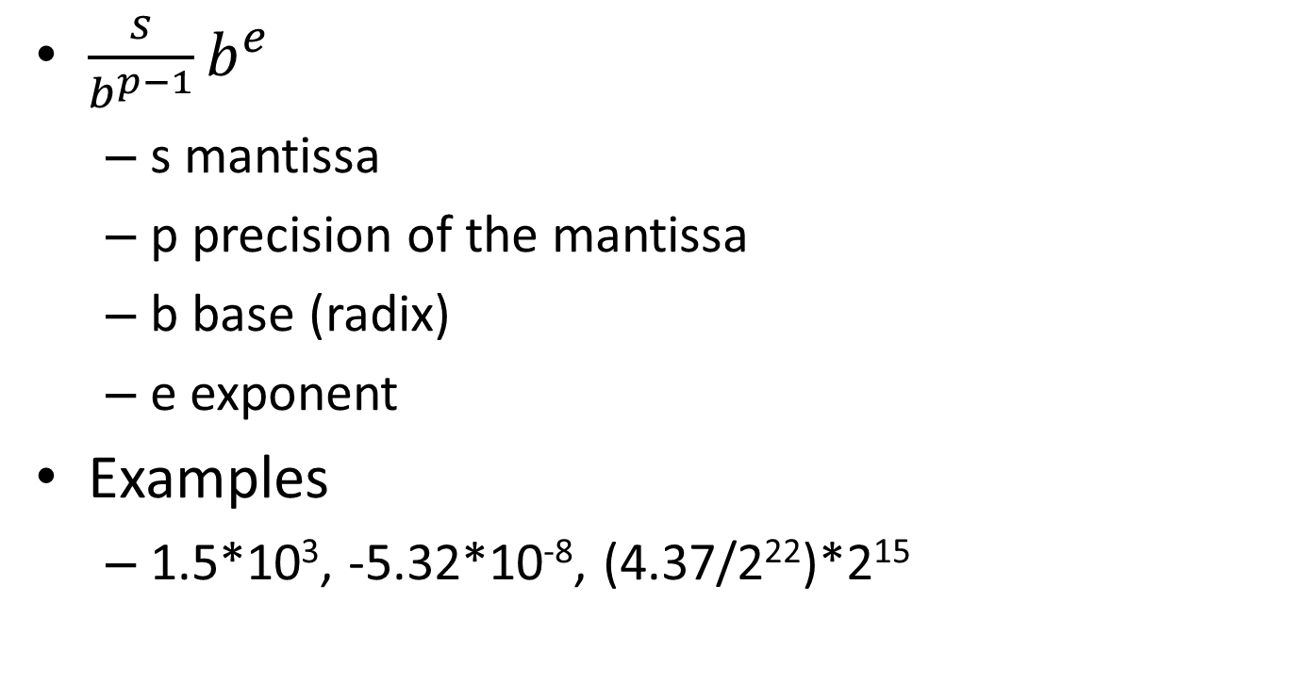
Floating Point Numbers
$\frac{s}{b^{p−1}}b^{e}$
s mantissa
p precision of the mantissa
b base (radix)
e exponent
Examples
1.5*10³, -5.32*10⁻⁸, (4.37/2²²)*2¹⁵
1. https://en.wikipedia.org/wiki/Floating_point

Slide 18
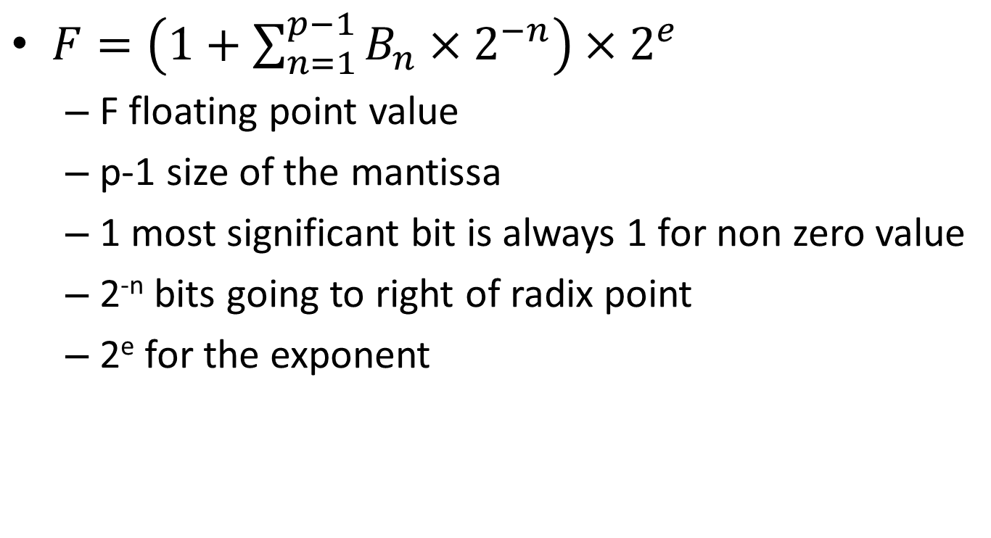
Floating Point Numbers (cont.)
$F=\left(1+\sum_{n=1}^{p−1}{B_{n}×2^{−n}}\right)×2^{e}$
F floating point value
p-1 size of the mantissa
1 most significant bit is always 1 for non zero value
2^{-n} bits going to right of radix point
2e for the exponent

Slide 19
Single Precision (float)
23 bits
Mantissa
8 bits
Exponent
Also signed
10⁻³⁸ to 10³⁸
Flag Bit
If 0, then positive
If 1, then negative
3. https://en.wikipedia.org/wiki/IEEE_floating_point#IEEE_754-2008

Slide 20
Double Precision (double)
52 bits
Mantissa
11 bits
Exponent
Also signed
10⁻³⁰⁸ to 10³⁰⁸
Flag Bit
If 0, then positive
If 1, then negative

Slide 21
Character Type
char
8 bit
Defined by ASCII
Originally 7 bits. But, Hey! Progress!
Get all values from ASCII tables
Remember to put a 0 in front
Traditional ASCII

Slide 22
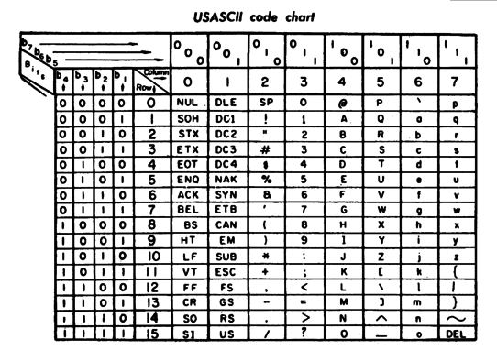
ASCII Table
4. https://en.wikipedia.org/wiki/ASCII

Slide 23

Reading ASCII Table
Bit format
$b_{7}b_{6}b_{5} { b}_{4}b_{3}b_{2}b_{1}$
Ex: character a
${110 0001}_{2}=1∗2^{6}+1∗2^{5}+1∗2^{0}={97}_{10}$

Slide 24
Further Reading
D. Knuth, The Art of Computer Programming Vol. 2, Addison-Wesley, 1997
http://www.cse.msu.edu/~cse320/Documents/FloatingPoint.pdf
IEEE 754-2008 revision

